Slide 1
Effects of Team-Building and Personality on Social Loafing
Andrew Bates & Michelle Wheeler
Hanover College

Slide 2
Social Loafing on Everyday Life
Do you dread small group work?
Do you prefer working individually?
Have you ever pulled more than your own weight in a task?

Slide 3
What is Social Loafing?
Social loafing is the tendency for individuals to exert less effort when working collectively in a group than when working individually (Karau & Williams, 1997)
Ringlemann Effect, 1913 (Kravitz & Martin, 1986)
Physical task: rope pulling
Decreased maximum force exerted when pulling together.

Slide 4
Why do People Engage in Social Loafing?
Steiner, 1972
Group effectiveness model: Loss of motivation/lack of coordination
Ability to “hide in the crowd”
Group work helps people to escape blame and responsibility
Harkins & Petty, 1982
Accountability
Identifiability

Slide 5
Why Might Team-Building Help?
Group Cohesion: “degree to which members stick together, in any or all of several possible ways, so the group has unity” (Newcomb, Turner & Converse, 1965).
High cohesive groups generated more ideas and were less likely to engage in social loafing than low cohesive groups (Karau & Hart, 1998).

Slide 6
Group Cohesion in Team-Building
Found that team-building activities help people learn how to work together for a common goal that will lead them to work more effectively and have a unity of purpose (Yuckelson, 1997).
Groups benefit from social interaction instead of diving straight into the task at hand (Holt, 1987).

Slide 7
Personality Influence in Team-Building
Engler, 2009
Extroverts tend to be more sociable and assertive
Introverts tend to be more quiet, passive and solitary
Barry & Stewarts, 1997
Found that Individuals with extraversion like traits showed more positive feelings while working with others.
Extroverts tend to have more cohesion within the group

Slide 8
Hypotheses
We predicted that college students who participated in a team-building activity will engage in less social loafing than students who did not
We predicted that the effect of team-building will be moderated by extraversion, such that team-building will reduce social loafing among extroverts more so than among introverts.

Slide 9
Participants
Participants: Hanover College Students
N= 38
18-23 years old
33 females, 5 males

Slide 10
Procedure
Control
Filler Task
Idea generation task
Big Five Personality Test
Team-Building Group
Team-building activity
Idea generation task
Big Five Personality Test

Slide 11
Collective vs. Coactive
Collective: Responses in idea generation task are pooled together and compared with other groups
Coactive: Responses are collected individually and compared to all other individuals

Slide 12
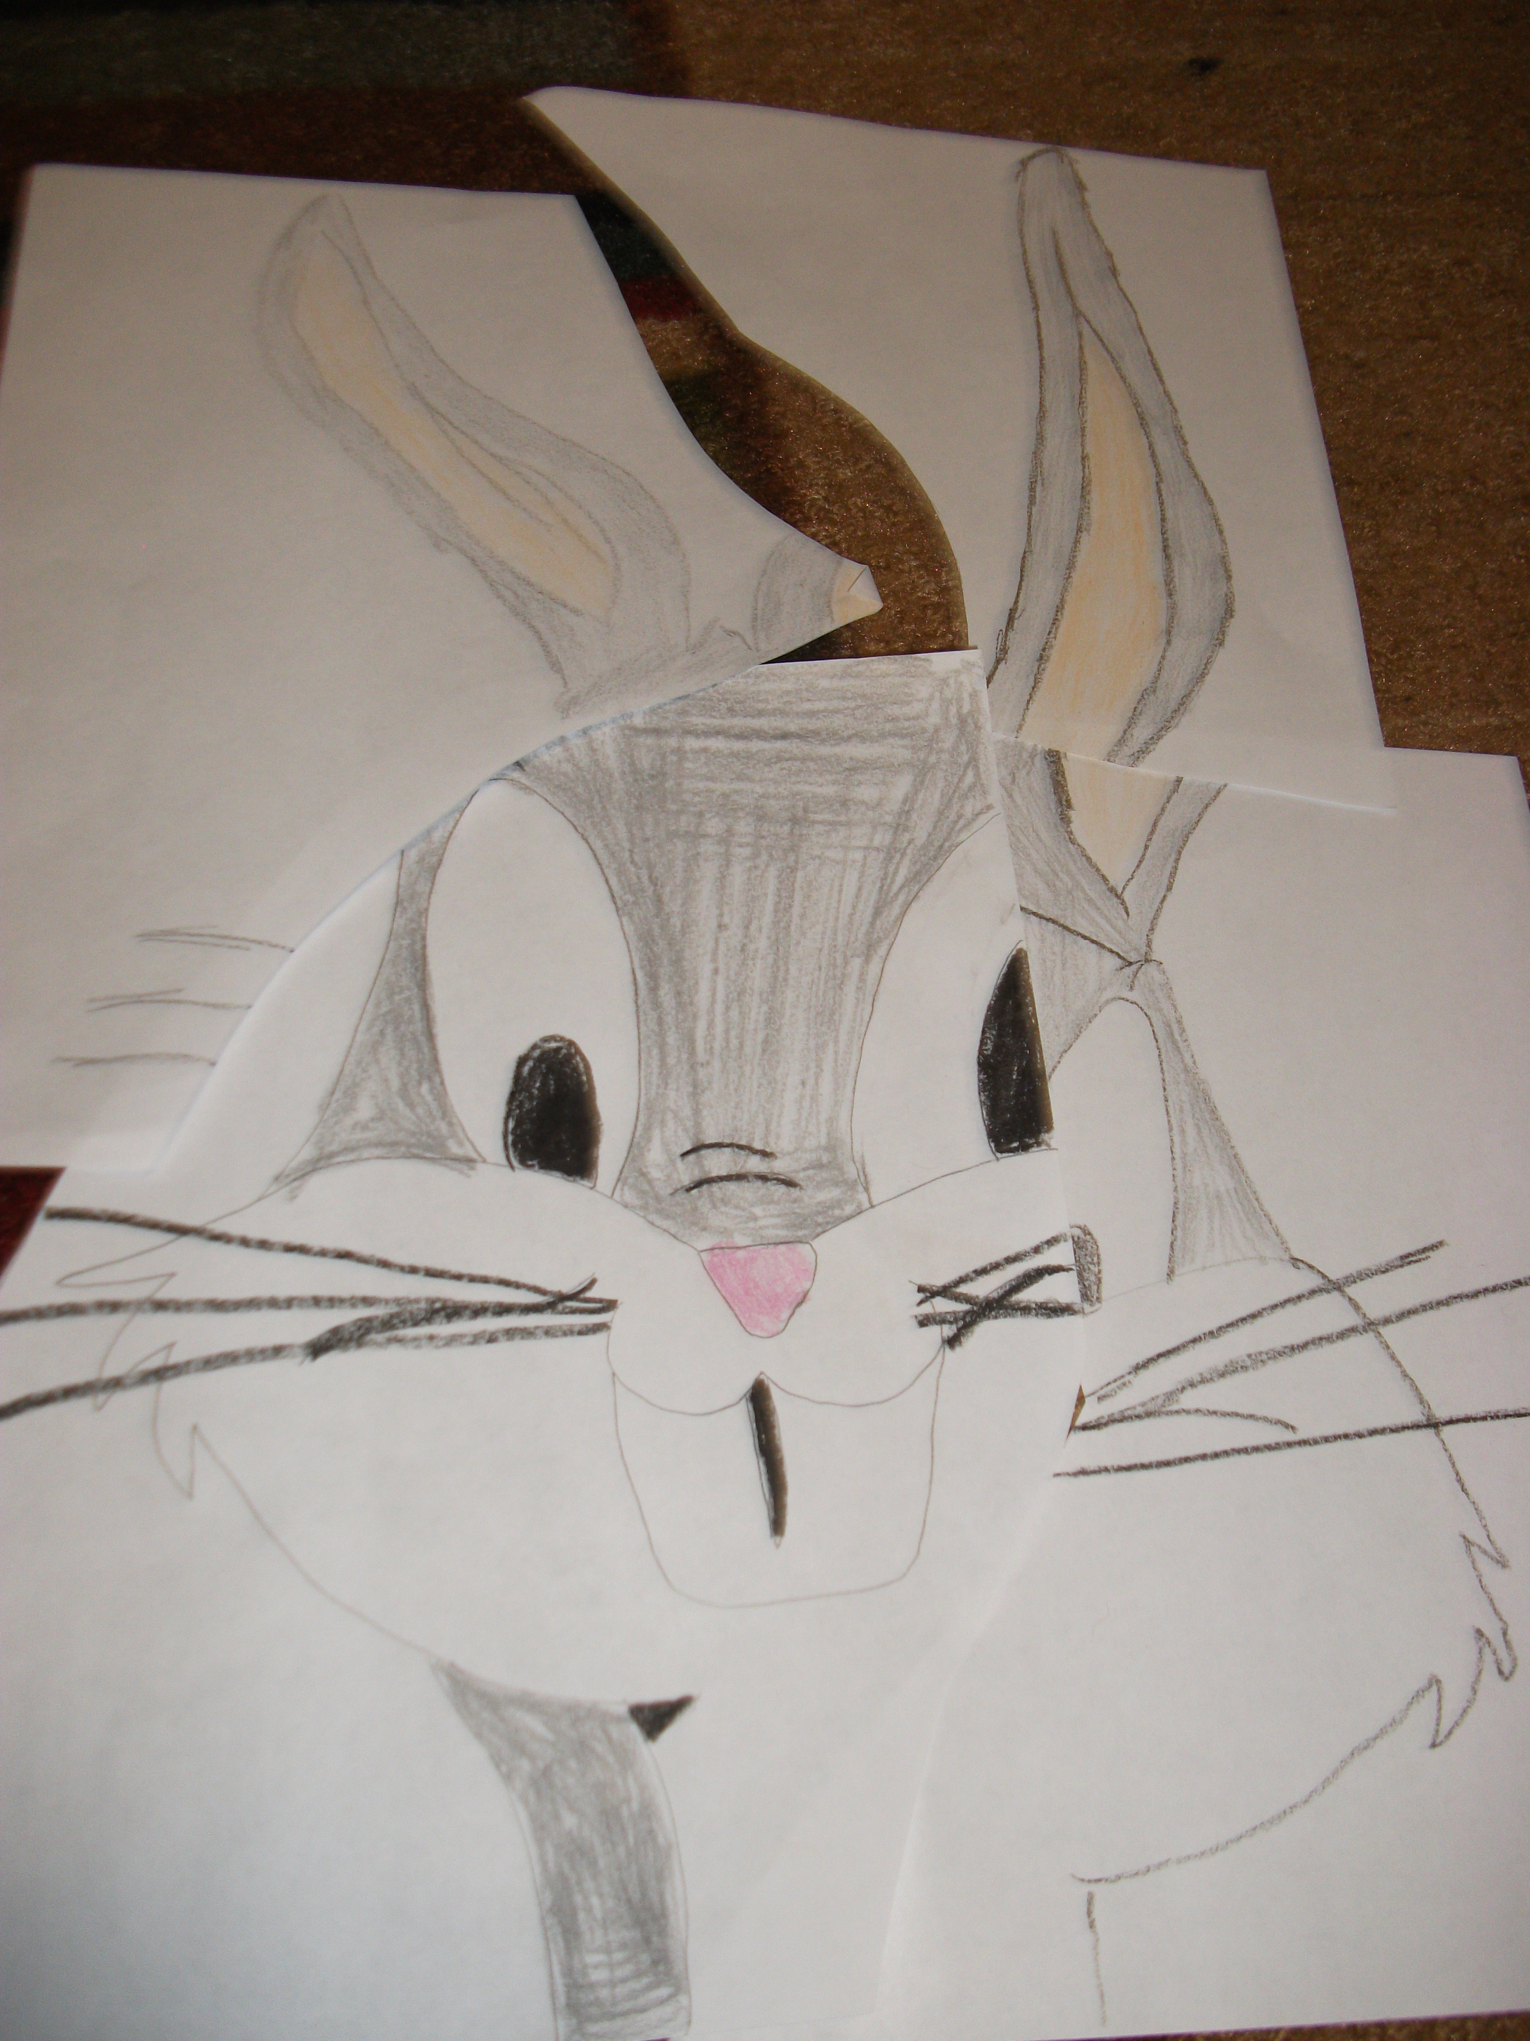
Team-Building Activity

Slide 13
Big Five Test Sample
1-5: not at all true –very true of me
I see myself as:
_____ talkative
_____ assertive
_____ energetic

Slide 14
Expected Results
Notes:
I think I’d still show a (non-significant) social loafing effect for the experimental group.

Slide 15
Results

Slide 16
Discussion
No evidence of social loafing in either the control or experimental condition
Interesting activities overall prevent social loafing
Pre-existence of group cohesion among certain groups

Slide 17
Future Directions
Number of participants
More demanding task
Room setting
Diverse gender representation

Slide 18
QUESTIONS!?

